Slide 1

Application of Text Quantification and Analysis for Document Classification

Slide 2
Outline
What data set will we use?
How will we quantify and transform the data?
How can the transformation be used for classification?
How can we visualize the data?
What practical applications does this have?

Slide 3
Data: Textual Movie Reviews
Provided by Cornell University
1000 positive movie reviews
1000 negative movie reviews

Slide 4

Quantification and Transformation: TF-IDF
Term Frequency
How many times does it appear in the document currently being investigated?
Inverse Document Frequency
How many times does it appear in the corpus?
Term weighting
Simplified:
Essential Parameters:
Minimum Document Frequency
Maximum Document Frequency
N-gram Range
Vectorization
Each document becomes a sparse vector
A positive number for each n-gram that appears in the document
A zero for each n-gram that appears in other documents, but not that particular one

Slide 5
Explaining TF-IDF Parameters
The quick brown fox jumps over the lazy dog.
The quick brown fox jumps over the lazy dog.
The quick brown fox jumps over the lazy dog.
The fast brown fox hurdles the cute dog.
The fast brown fox hurdles the cute dog.
The fast fox hurdles the cute dog.
The fast fox hurdles the cute dog.
Maximum document frequency =
3
2
Minimum document frequency =
1
2
1
N-gram Size:
3
1
2
The quick fast brown fox jumps hurdles over lazy cute dog
The quick brown quick brown fox brown fox jumps fox jumps over over the lazy the lazy dog the fast brown fast brown fox brown fox hurdles fox hurdles the hurdles the cute the cute dog the fast fox fast fox hurdles
The quick quick brown brown fox fox jumps jumps over over the the lazy lazy dog The fast fast brown fox hurdles hurdles the the cute cute dog fast fox
6 1 2 2 3 1 2 1 1 2 3
1 1 2 1 1 1 1 1 2 1 2 2 2 2 1
1 1 1 1 1 1 1 1 1 2 2 2 1 1
Total terms:
14
11
15
Feature count:
24
21
17

Slide 6
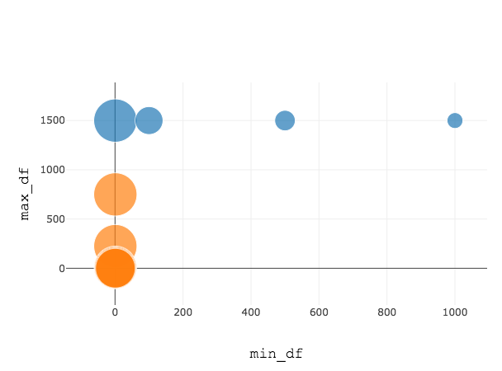
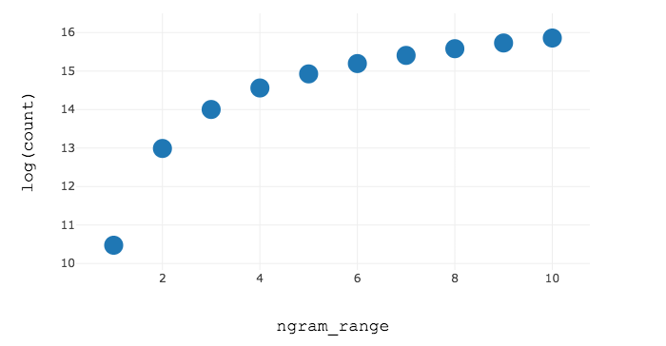
Effect of parameter variation on training data set
Feature count rapidly decreases as min_df increases
Most terms don't appear in more than a few documents
Feature count doesn't significantly decrease until max_df is in single digits
Confirming that most terms don't appear in more than a few documents
Feature count is cumulative
The count increases linearly past an n-gram range of 3
No new phrases are uncovered after this point, only extensions of previously found phrases

Slide 7
Applying the vectorization: Document Classification
Each document is either a positive or negative review
Using the training set, we vectorize the corpus with a variety of TF-IDF parameters
Each set of TF-IDF parameters generates a unique term-weighting scheme
Each vector is now a high-dimensional set of numbers
We can apply numerical classification tools
K-Nearest Neighbors Classification
Linear Support Vector Classification

Slide 8
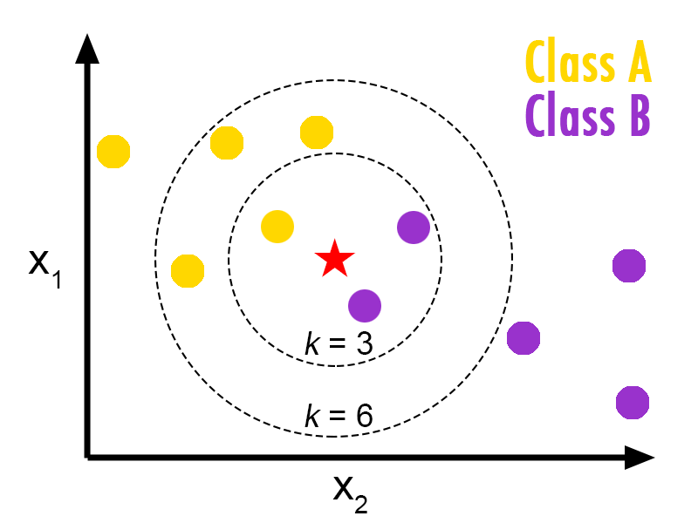
K-Nearest Neighbor Classification
Classify based on neighbors
Here we see a simple example
Ours has many more dimensions
Fully non-parametric
http://en.proft.com.ua/media/science/r_knn_concept.png

Slide 9
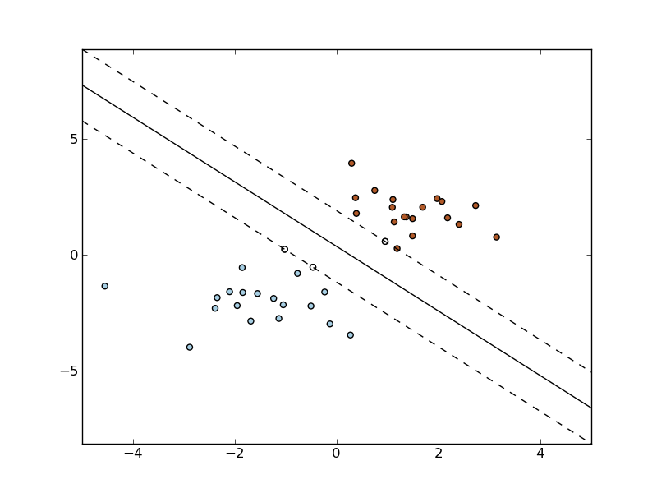
Linear Support Classifier Vectorization
Maximizes the margin between two binary sets of data
Our vectors are much more complex but the principle is the same
The penalty for misclassifying data, C, can be changed to limit overfitting
Assumes linearly separable data sets
This assumption adds bias but improves accuracy when correct
http://scikit-learn.sourceforge.net/0.6/_images/plot_separating_hyperplane.png

Slide 10
Best results for Linear SCV and KNN Classification
Linear SCV KNN Classification
Min DF | 1
Max DF | .75
N-gram Range | (1,2)
Confusion Matrix | 195 49 35 221
Success Rate | 83.2%
Min DF | 1
Max DF | .85
N-gram Range | (1,3)
Confusion Matrix | 171 73 40 216
Success Rate | 77.4%

Slide 11
Misclassified documents
Some documents had very limited clear positive or negative sentiment
Excerpts:
"i was pleasantly surprised how sharp the comedy was, with very funny scenes... Particularly enjoyed a shot of sammy dangling his legs from a max-sized chair... The characters head to new york and the film takes a dive. off the high board... Indeed, many scenes stuck out of this film like incorrectly placed puzzle piece."
"Urban legend begins with a sequence that reminded me of the classic scream opener, not so much in plotting as in attention to detail that makes for an absolutely chilling teaser for the rest of the film… The attendant ends up coaxing her onto the main building to sort out a problem with the credit card company… The obvious candidate is the slightly off-kilter professor at the college the girl went to…"

Slide 12
2-Dimensional Data Visualization
Because the data focuses on sentiment polarity, the reviews can be assessed using sentiment analysis and visualized accordingly
After being transformed into TF-IDF vectors, complexity increases significantly
Because the data now exists in high dimensions, some transformation is required
Since we are interested in a 2-dimensional visualization, dimension reduction tools are needed
Randy's Favorite: Principal Component Analysis
Manifold Learning (Non-linear dimensionality reduction)

Slide 13
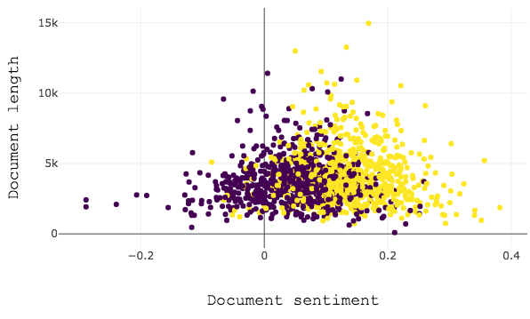
Sentiment Analysis
Good results
Only works because the data set is specifically focused on sentiment polarity
Not generalizable

Slide 14
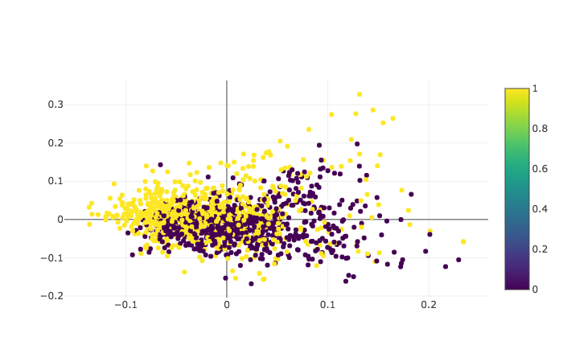
Principal Component Analysis
Some separation, but not great
PCA assumes linear relationships in data
Relationships between words in English sentences are not linear
For example:
Hey Jude, don't make
Hey Jude, don't make it bad
Hey
Hey Jude
Hey Jude, don't make it
Hey
Hey Jude, don't

Slide 15
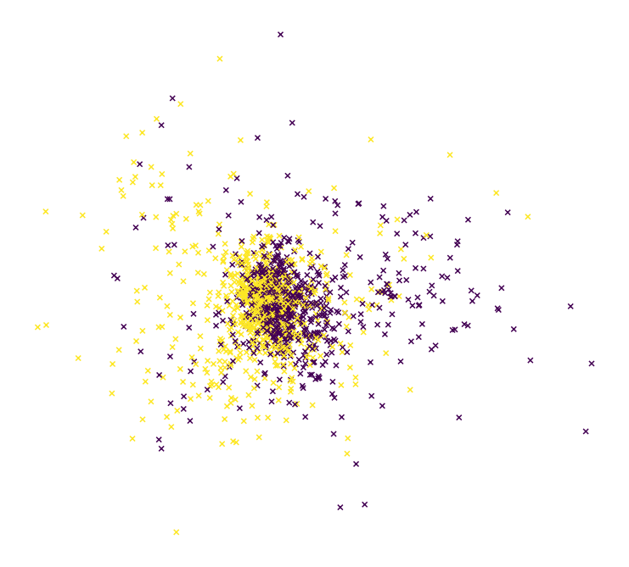
Manifold Learning
Does not assume linear relationships
Many different methodologies, all extremely complex
We tried several and settled on one called spectral embedding
Uses Laplacian Eigenmaps

Slide 16
Applications of TF-IDF vectorization
Visualization plots were a bit messy but classification worked relatively well
So what can we do with classification?
Search engine optimization
Relies on correlation of key words
Document recommendation schemes
Relies on correlation of topics
User modeling
Customizes a system based on a user's particular focus
Fundamentally, a modification of the weighting scheme used by TF-IDF

Slide 17
Other applications
Automated classification of user-generated corpus

Slide 18


Slide 19
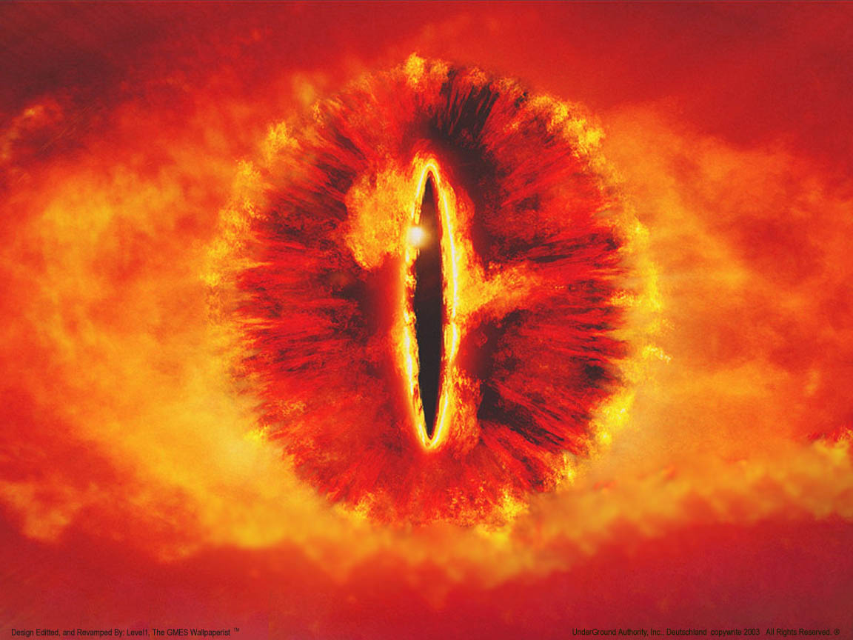
Questions?

